Slide 1


International Economics: Theory and Policy
Twelfth Edition
Chapter 16
Price Levels and the Exchange Rate in the Long Run
Copyright © 2022, 2018, 2015 Pearson Education, Inc. All Rights Reserved
Notes:
If this PowerPoint presentation contains mathematical equations, you may need to check that your computer has the following installed:
1) MathType Plugin
2) Math Player (free versions available)
3) NVDA Reader (free versions available)

Slide 2
Learning Objectives
16.1 Explain the purchasing power parity theory of exchange rates and the theory’s relationship to international goods-market integration.
16.2 Describe how monetary factors such as ongoing price level inflation affect exchange rates in the long run.
16.3 Discuss the concept of the real exchange rate.
16.4 Understand factors that affect real exchange rates and relative currency prices in the long run.
16.5 Explain the relationship between international real interest rate differences and expected changes in real exchange rates.

Slide 3
Preview
Law of one price
Purchasing power parity
Long-run model of exchange rates: monetary approach
Relationship between interest rates and inflation: Fisher effect
Shortcomings of purchasing power parity
Long-run model of exchange rates: real exchange rate approach
Real interest rates

Slide 4
The Behavior of Exchange Rates (1 of 2)
What models can predict how exchange rates behave?
In last chapter we developed a short-run model and a long-run model that used movements in the money supply.
In this chapter, we develop two more models, building on the long-run approach from last chapter.
Long run means a sufficient amount of time for prices of all goods and services to adjust to market conditions so that their markets and the money market are in equilibrium.
Because prices are allowed to change, they will influence interest rates and exchange rates in the long-run models.

Slide 5
The Behavior of Exchange Rates (2 of 2)
The long-run models are not intended to be completely realistic descriptions about how exchange rates behave, but ways of representing how market participants may form expectations about future exchange rates and how exchange rates tend to move over long periods.

Slide 6
Law of One Price (1 of 3)
The law of one price simply says that the same good in different competitive markets must sell for the same price, when transportation costs and barriers between those markets are not important.
Why? Suppose the price of pizza at one restaurant is $20, while the price of the same pizza at an identical restaurant across the street is $40.
What do you predict will happen? Many people will buy the $20 pizza, few will buy the $40 one.

Slide 7
Law of One Price (2 of 3)
Due to the price difference, entrepreneurs would have an incentive to buy pizza at the cheap location and sell it at the expensive location for an easy profit.
Due to strong demand and decreased supply, the price of the $20 pizza would tend to increase.
Due to weak demand and increased supply, the price of the $40 pizza would tend to decrease.
People would have an incentive to adjust their behavior and prices would tend to adjust until one price is achieved across markets (across restaurants).

Slide 8
Law of One Price (3 of 3)
Consider a pizza restaurant in Seattle and one across the border in Vancouver.
The law of one price says that the price of the same pizza (using a common currency to measure the price) in the two cities must be the same if markets are competitive and transportation costs and barriers between markets are not important.

Slide 9
Purchasing Power Parity (1 of 3)
Purchasing power parity is the application of the law of one price across countries for all goods and services, or for representative groups (“baskets”) of goods and services.

Slide 10
Purchasing Power Parity (2 of 3)
Purchasing power parity (P P P) implies that the exchange rate is determined by levels of average prices
If the price level in the United States is US$200 per basket, while the price level in Canada is C$400 per basket, P P P implies that
the C$/US$ exchange rate should be
Predicts that people in all countries have the same purchasing power with their currencies: 2 Canadian dollars buy the same amount of goods as 1 U.S. dollar, since prices in Canada are twice as high.

Slide 11
Purchasing Power Parity (3 of 3)
Purchasing power parity (P P P) comes in two forms:
Absolute P P P: purchasing power parity that has already been discussed. Exchange rates equal the level of relative average prices across countries.
Relative P P P: changes in exchange rates equal changes in prices (inflation) between two periods:
where

Slide 12
Monetary Approach to Exchange Rates (1 of 5)
Monetary approach to the exchange rate: uses monetary factors to predict how exchange rates adjust in the long run, based on the absolute version of P P P.
It predicts that levels of average prices across countries adjust so that the quantity of real monetary assets supplied will equal the quantity of real monetary assets demanded:

Slide 13
Monetary Approach to Exchange Rates (2 of 5)
To the degree that P P P holds and to the degree that prices adjust to equate the quantity of real monetary assets supplied with the quantity of real monetary assets demanded, we have the following prediction:
The exchange rate is determined in the long run by prices, which are determined by the relative supply and demand of real monetary assets in money markets across countries.

Slide 14
Monetary Approach to Exchange Rates (3 of 5)
Predictions about changes in
Money supply: a permanent rise in the domestic money supply
causes a proportional increase in the domestic price level,
thus causing a proportional depreciation in the domestic currency (through P P P).
This is same prediction as long-run model without P P P.
Interest rates: a rise in domestic interest rates
lowers the demand of real monetary assets,
and is associated with a rise in domestic prices,
thus causing a proportional depreciation of the domestic currency (through P P P).

Slide 15
Monetary Approach to Exchange Rates (4 of 5)
Output level: a rise in the domestic level of production and income (output)
raises domestic demand of real monetary assets,
and is associated with a decreasing level of average domestic prices (for a fixed quantity of money supplied),
thus causing a proportional appreciation of the domestic currency (through P P P).
All three changes affect money supply or money demand, and cause prices to adjust so that the quantity of real monetary assets supplied matches the quantity of real monetary assets demanded, and cause exchange rates to adjust according to P P P.

Slide 16
Monetary Approach to Exchange Rates (5 of 5)
A change in the money supply results in a change in the level of average prices.
A change in the growth rate of the money supply results in a change in the growth rate of prices (inflation).
A constant growth rate in the money supply results in a persistent growth rate in prices (persistent inflation) at the same constant rate, when other factors are constant.
Inflation does not affect the productive capacity of the economy and real income from production in the long run.
Inflation, however, does affect nominal interest rates. How?

Slide 17
The Fisher Effect (1 of 2)
The Fisher effect (named affect Irving Fisher) describes the relationship between nominal interest rates and inflation.
Derive the Fisher effect from the interest parity condition:
If financial markets expect (relative) P P P to hold, then expected exchange rate changes will equal expected inflation between countries:

Slide 18
The Fisher Effect (2 of 2)
Therefore,
The Fisher effect: a rise in the domestic inflation rate causes an equal rise in the interest rate on deposits of domestic currency in the long run, when other factors remain constant.

Slide 19
Monetary Approach to Exchange Rates (1 of 2)
Suppose that the U.S. central bank unexpectedly increases
the growth rate of the money supply at time
Suppose also that the inflation rate is
in the United States
before
after this time, but that the European
inflation rate remains at 0%.
According to the Fisher effect, the interest rate in the United States will adjust to the higher inflation rate.

Slide 20
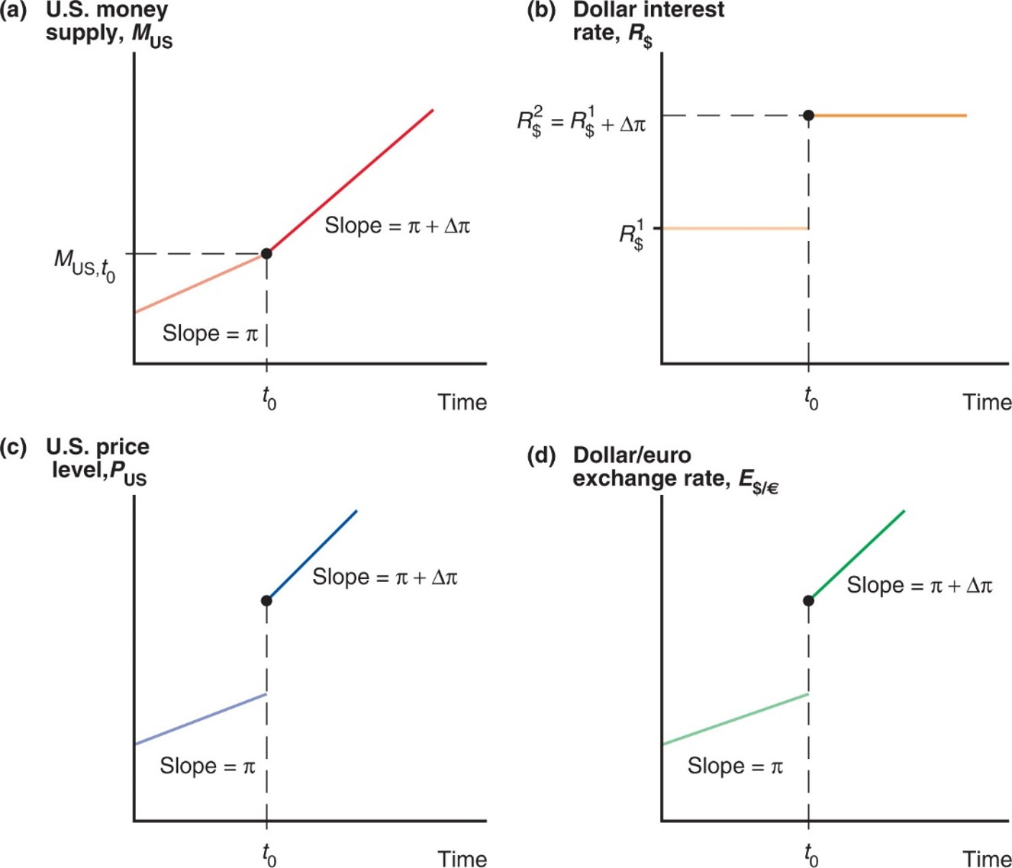
Figure 16.1 Long-Run Time Paths of U.S. Economic Variables After a Permanent Increase in the Growth Rate of the U.S. Money Supply
Notes:
Graph ay plots U S money supply, M sub U S, versus time. The plot is a rising line with slope = pi, to point (t sub 0, M sub U S, t sub 0). After the increase, the line continues more steeply, with slope = pi + delta pi. Graph b plots dollar interest rate, R sub dollars, versus time. The plot is a horizontal line first at y = R sub dollars super 1, to x = t sub 0, and then moving up to another horizontal line at y = R sub dollars super 2 = R sub dollars super 1 + delta pi. Graph c plots U S price level, P sub U S, versus time. The plot is a line with slope = pi, to x = t sub 0. After the increase, the line jumps up to a new position at x = t sub 0 and rises more steeply, with slope = pi + delta pi. Graph d plots dollar to euro exchange rate, E sub dollars to euros, versus time. The plot is a line with slope = pi, to x = t sub 0. After the increase, the line jumps up to a new position at x = t sub 0 and rises more steeply, with slope = pi + delta pi.
After the money supply growth rate increases at time t sub 0 in panel (a), the interest rate [in panel (b)], price level [in panel (c)], and exchange rate [in panel (d)] move to new long-run equilibrium paths.

Slide 21
Monetary Approach to Exchange Rates (2 of 2)
The increase in nominal interest rates decreases the demand of real monetary assets.
In order for the money market to maintain equilibrium in the long run, prices must jump so that
In order to maintain P P P, the exchange rate must jump (the dollar must depreciate) so that
Thereafter, the money supply and prices are predicted to grow at rate
and the domestic currency is predicted to depreciate at the same rate.

Slide 22
The Role of Inflation and Expectations (1 of 3)
In the long-run model without P P P:
Changes in money supply lead to changes in the level of average prices.
No inflation is predict to occur in the long run, but only during the transition to the long-run equilibrium.
During the transition, inflation causes the nominal interest rate to increase to its long-run value.
Expectations of higher domestic inflation cause the expected return on foreign currency deposits to increase, making the domestic currency depreciate before the transition period.

Slide 23
The Role of Inflation and Expectations (2 of 3)
In the monetary approach (with P P P), the rate of inflation increases permanently when the growth rate of the money supply increases permanently.
With persistent domestic inflation (above foreign inflation), the monetary approach also predicts an increase in the domestic nominal interest rate.
Expectations of higher domestic inflation cause the expected purchasing power of domestic currency to decrease relative to the expected purchasing power of foreign currency, thereby making the domestic currency depreciate.

Slide 24
The Role of Inflation and Expectations (3 of 3)
In the long-run model without P P P, the level of average prices does not immediately adjust even if expectations of inflation adjust,
causing the exchange rate to overshoot (causing the domestic currency to depreciate more than) its long-run value.
In the monetary approach (with P P P), the level of average prices adjusts with expectations of inflation,
causing the domestic currency to depreciate, but with no overshooting.

Slide 25
Shortcomings of P P P (1 of 5)
There is little empirical support for absolute purchasing power parity.
The prices of identical commodity baskets, when converted to a single currency, differ substantially across countries.
Relative P P P is more consistent with data, but it also performs poorly to predict exchange rates.

Slide 26
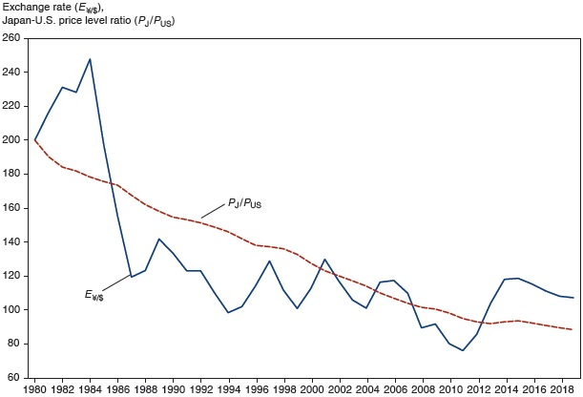
Figure 16.2 The Yen/Dollar Exchange Rate and Relative Japan–U.S. Price Levels, 1980–2019
Relative P P P does not track the yen/dollar exchange rate 1980-2015.
Source: I M F, International Financial Statistics. Exchange rates and price levels are end of the year data,.
Notes:
A double line graph plots the yen to dollar exchange rate and relative Japan to U S price levels versus year, 19 80 to 20 18. The exchange rate rises from 200 in 19 80 to a peak of 250 in 19 84. In 19 87, it drops to 117 and then continues to fluctuate between 80 and 140 until 20 14, and ends at 120 in 20 18. The price level ratio falls steadily from 200 in 19 80 to 90 in 20 18. All values are estimated.

Slide 27
Shortcomings of P P P (2 of 5)
Reasons why P P P may not be accurate: the law of one price may not hold because of
Trade barriers and nontradable products
Imperfect competition
Differences in measures of average prices for baskets of goods and services

Slide 28
Shortcomings of P P P (3 of 5)
Trade barriers and nontradable products
Transport costs and governmental trade restrictions make trade expensive and in some cases create nontradable goods or services.
Services are often not tradable: services are generally offered within a limited geographic region (e.g., haircuts).
The greater the transport costs, the greater the range over which the exchange rate can deviate from its P P P value.
One price need not hold in two markets.

Slide 29
Shortcomings of P P P (4 of 5)
Imperfect competition may result in price discrimination: “pricing to market.”
A firm sells the same product for different prices in different markets to maximize profits, based on expectations about what consumers are willing to pay.
One price need not hold in two markets.

Slide 30
Shortcomings of P P P (5 of 5)
Differences in the measure of average prices for goods and services
Levels of average prices differ across countries because of differences in how representative groups (“baskets”) of goods and services are measured.
Because measures of groups of goods and services are different, the measure of their average prices need not be the same.
One price need not hold in two markets.

Slide 31

Law of One Price for Hamburgers?

Slide 32
Why Price Levels Are Lower in Poorer Countries (1 of 3)
When expressed in terms of a single currency, countries’ price levels are positively related to the level of real income per capita.
A dollar, when converted to local currency at the market exchange rate, generally goes much further in a poor country than in a rich one.
Figure 16-3 illustrates the relation between price levels and income, with each dot representing a different country.
Non-tradables tend to be more expensive (relative to tradables) in richer countries.

Slide 33
Why Price Levels Are Lower in Poorer Countries (2 of 3)
The Balassa-Samuelson theory assumes labor productivity in poor countries is than in rich countries for tradables but not for non-tradables.
If the prices of traded goods are roughly equal across countries, the lower labor productivity in the tradables industries of poor countries implies lower wages, lower production costs in non-tradables, and thus lower prices of non-tradables than rich countries.
Productivity statistics support the Balassa-Samuelson differential productivity explanation.

Slide 34
Why Price Levels Are Lower in Poorer Countries (3 of 3)
An alternative theory (by Bhagwati, Kravis, and Lipsey) relies on differences in the endowments of capital and labor, rather than productivity differences.
The higher capital-labor ratios in rich countries compared to poor countries makes the marginal productivity of labor and hence the wage level higher in rich countries.
Non-tradables are labor-intensive (use a higher ratio of labor to capital) relative to tradables, making non-tradables cheaper in poor, low-wage countries than they are in rich, high-wage countries.
Rich countries thus have higher overall price levels.

Slide 35
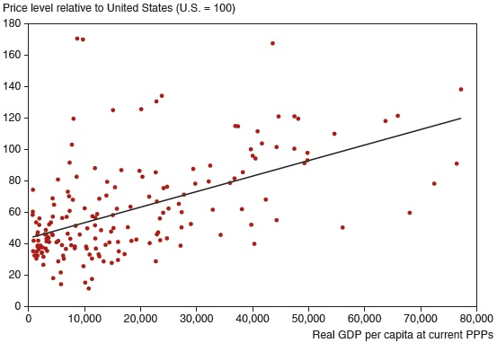
Figure 16.3 Price Levels and Real Incomes, 2017
Consumer price levels tend to rise as their real income rises. Each dot represents a country. The straight line represents a statistician’s best prediction of a country’s price level relative to that of the United States based on its real per capita income.
Source: Penn World Table, version 9.1.
Notes:
The vertical axis ranges from 0 to 180, in increments of 20. The horizontal axis ranges from 0 to 80,000, in increments of 10,000. A line rises through the data points from (0, 42) to (70,000, 125). The data points are clustered between (1,000, 30) and (1,000, 55), with points more widely dispersed and less frequent as the line rises. All values are estimated.

Slide 36
The Real Exchange Rate Approach to Exchange Rates (1 of 10)
Because of the shortcomings of P P P, economists have tried to generalize the monetary approach to P P P to make a better theory.
The real exchange rate is the rate of exchange for goods and services across countries.
In other words, it is the relative value/price/cost of goods and services across countries.
For example, it is the dollar price of a European group of goods and services relative to the dollar price of an American group of goods and services:

Slide 37
The Real Exchange Rate Approach to Exchange Rates (2 of 10)
If the E U basket costs
the U.S. basket costs $120, and the
nominal exchange rate is $1.20 per euro, then the real exchange rate is 1 U.S. basket per 1 E U basket.
A real depreciation of the value of U.S. products means a fall in a dollar′s purchasing power of EU products relative to a dollar′s purchasing power of U.S. products.
This implies that U.S. goods become less expensive and less valuable relative to EU goods.
This implies that the value of U.S. goods relative to value of EU goods falls.

Slide 38
The Real Exchange Rate Approach to Exchange Rates (3 of 10)
A real appreciation of the value of U.S. products means a rise in a dollar’s purchasing power of E U products relative to a dollar’s purchasing power of U.S. products.
This implies that U.S. goods become more expensive and more valuable relative to E U goods.
This implies that the value of U.S. goods relative to value of E U goods rises.

Slide 39
The Real Exchange Rate Approach to Exchange Rates (4 of 10)
According to P P P, exchange rates are determined by relative average prices:
According to the more general real exchange rate approach, exchange rates may also be influenced by the real exchange rate:
What influences the real exchange rate?

Slide 40
The Real Exchange Rate Approach to Exchange Rates (5 of 10)
A change in relative demand of U.S. products
An increase in relative demand of U.S. products causes the value (price) of U.S. goods relative to the value (price) of foreign goods to rise.
A real appreciation of the value of U.S. goods:
rises relative to
The real appreciation of the value of U.S. goods makes U.S. exports more expensive and imports into the U.S. less expensive (thereby reducing the relative quantity demanded of U.S. products).
A decrease in relative demand of U.S. products causes a real depreciation of the value of U.S. goods.

Slide 41
The Real Exchange Rate Approach to Exchange Rates (6 of 10)
A change in relative supply of U.S. products
An increase in relative supply of U.S. products (caused by an increase in U.S. productivity) causes the price/cost of U.S. goods relative to the price/cost of foreign goods to fall.
A real depreciation of the value of U.S. goods:
falls relative to
The real depreciation of the value of U.S. goods makes U.S. exports less expensive and imports into the United States more expensive (thereby increasing relative quantity demanded to match increased relative quantity supplied).
A decrease in relative supply of U.S. products causes a real appreciation of the value of U.S. goods.

Slide 42
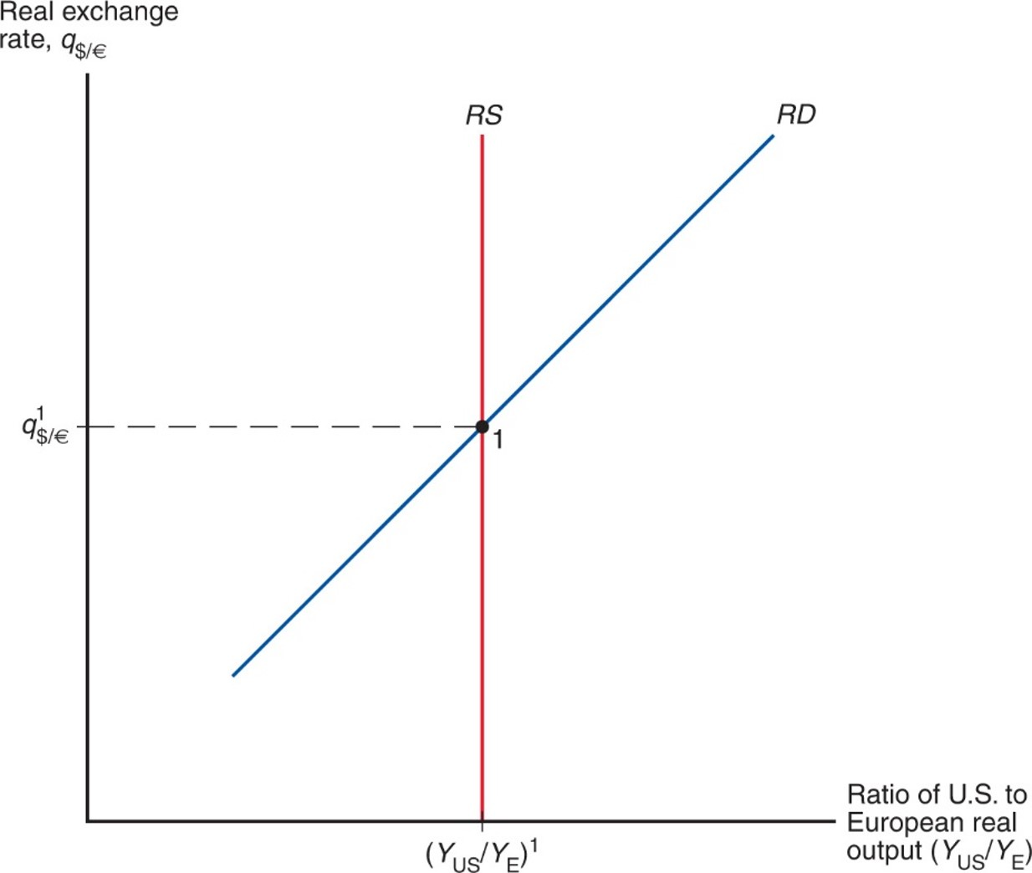
Figure 16.4 Determination of the Long-Run Real Exchange Rate
The long-run equilibrium real exchange rate equates world relative demand to the full-employment level of relative supply.
Notes:
The R S curve is a vertical line at x = left parenthesis, Y sub U S over Y sub E, right parenthesis, super 1. R S intersects a rising R S curve at point 1, where y = real exchange rate super 1.
Suppose the supply of long run output in the US economy is equal to Y¹_{US} and the supply of long run output in the EU is equal to Y¹_{EU}. In the long run, these two quantities depend on the productive capacity of the respective economy--on factors of production like labor, physical capital, technology, natural resources, and so on. They do not depend on the real exchange rate. That is, they do not depend on the nominal exchange rate, nor the price levels in either economy. Thus, the relative supply of US products, (Y_{US}/Y_{EU}⁾¹, is also independent of the real exchange rate. We represent this independence by drawing a vertical line in the graph.

Slide 43
The Real Exchange Rate Approach to Exchange Rates (7 of 10)
The real exchange rate is a more general approach to explain exchange rates. Both monetary factors and real factors influence nominal exchange rates:
1a. Increases in monetary levels lead to temporary inflation and changes in expectations about inflation.
1b. Increases in monetary growth rates lead to persistent inflation and changes in expectations about inflation.
2a. Increases in relative demand of domestic products lead to a real appreciation.
2b. Increases in relative supply of domestic products lead to a real depreciation.

Slide 44
The Real Exchange Rate Approach to Exchange Rates (8 of 10)
What are the effects on the nominal exchange rate?
When only monetary factors change and P P P holds, we have the same predictions as before.
No changes in the real exchange rate occurs.
When factors influencing real output change, the real exchange rate changes.
With an increase in relative demand of domestic products, the real exchange rate adjusts to determine nominal exchange rates.
With an increase in relative supply of domestic products, the situation is more complex.

Slide 45
The Real Exchange Rate Approach to Exchange Rates (9 of 10)
With an increase in the relative supply of domestic products, the real exchange rate adjusts to make the price/cost of domestic goods depreciate, but the relative amount of domestic output also increases.
This second effect increases the demand of real monetary assets in the domestic economy:
Thus the level of average domestic prices is predicted to decrease relative to the level of average foreign prices.
The effect on the nominal exchange rate is ambiguous:

Slide 46
The Real Exchange Rate Approach to Exchange Rates (10 of 10)
When economic changes are influenced only by monetary factors, and when the assumptions of P P P hold, nominal exchange rates are determined by P P P.
When economic changes are caused by factors that affect real output, exchange rates are not determined by P P P only, but are also influenced by the real exchange rate.

Slide 47
Interest Rate Differences
A more general equation of differences in nominal interest rates across countries can be derived from
The difference in nominal interest rates across two countries is now the sum of
the expected rate of depreciation in the value of domestic goods relative to foreign goods, and
the difference in expected inflation rates between the domestic economy and the foreign economy.

Slide 48
Table 16.1 Effects of Money Market and Output Market Changes on the Long-Run Nominal Dollar/Euro Exchange Rate, E sub dollar per euro (1 of 2)
Money market
Change | Effect on the Long-Run Nominal Dollar/Euro Exchange Rate, E sub dollar per euro
1. Increase in U.S. money supply level | Proportional increase (nominal depreciation of $)
2. Increase in European money supply level | Proportional decrease (nominal depreciation of euro)
3. Increase in U.S. money supply growth rate | Increase (nominal depreciation of $)
4. Increase in European money supply growth rate | Decrease (nominal depreciation of euro)

Slide 49
Table 16.1 Effects of Money Market and Output Market Changes on the Long-Run Nominal Dollar/Euro Exchange Rate, E sub dollar per euro (2 of 2)
Table 16.1 [Continued]
Output market
Change | Effect on the Long-Run Nominal Dollar/Euro Exchange Rate, E sub dollar per euro
1. Increase in demand for U.S. output | Decrease (nominal appreciation of $)
2. Increase in demand for European output | Increase (nominal appreciation of euro)
3. Output supply increase in the United States | Ambiguous
4. Output supply increase in Europe | Ambiguous

Slide 50
Real Interest Rates (1 of 2)
Real interest rates are inflation-adjusted interest rates:
where
represents the expected inflation rate and
R represents a measure of nominal interest rates.
Real interest rates are measured in terms of real output:
the quantity of goods and services that savers can purchase when their assets pay interest
the quantity of goods and services that borrowers cannot purchase when they must pay interest on their loans
What are the predicted differences in real interest rates across countries?

Slide 51
Real Interest Rates (2 of 2)
Real interest rate differentials are derived from
The last equation is called real interest parity.
It says that differences in real interest rates (in terms of goods and services that are earned or forgone when lending or borrowing) between countries are equal to the expected change in the value/price/cost of goods and services between countries.

Slide 52
Summary (1 of 4)
The law of one price says that the same good in different competitive markets must sell for the same price, when transportation costs and barriers between markets are not important.
Purchasing power parity applies the law of one price for all goods and services among all countries.
Absolute P P P says that currencies of two countries have the same purchasing power.
Relative P P P says that changes in the nominal exchange rate between two countries equals the difference in the inflation rates between the two countries.

Slide 53
Summary (2 of 4)
The monetary approach to exchange rates uses P P P and the supply and demand of real monetary assets.
Changes in the growth rate of the money supply influence inflation and exchange rates.
Expectations about inflation influence the exchange rate.
The Fisher effect shows that differences in nominal interest rates are equal to differences in inflation rates.
Empirical support for P P P is weak.
Trade barriers, non-tradable products, imperfect competition, and differences in price measures may cause the empirical shortcomings of P P P.

Slide 54
Summary (3 of 4)
The real exchange rate approach to exchange rates generalizes the monetary approach.
It defines the real exchange rate as the value/price/cost of domestic products relative to foreign products.
It predicts that changes in relative demand and relative supply of products influence real and nominal exchange rates.
Interest rate differences are explained by a more general concept: expected changes in the value of domestic products relative to the value of foreign products plus the difference of inflation rates between the domestic and foreign economies.

Slide 55
Summary (4 of 4)
Real interest rates are inflation-adjusted interest rates, and show how much purchasing power savers gain and borrowers give up.
Real interest parity shows that differences in real interest rates between countries equal expected changes in the real value of goods and services between countries.

Slide 56
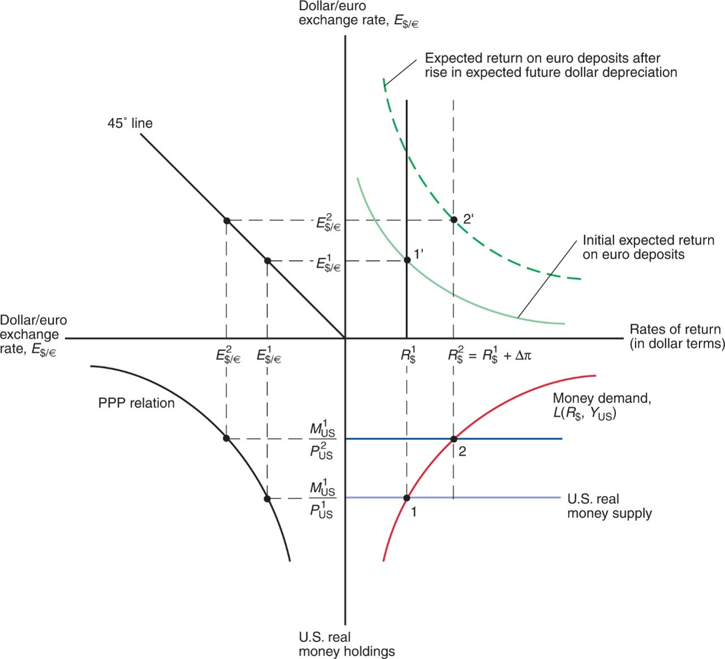
Figure 16A.1 How a Rise in U.S. Monetary Growth Affects Dollar Interest Rates and the Dollar/Euro Exchange Rate When Goods Prices Are Flexible
Notes:
A 45-degree line extends down to the right through a point where x and y both = E sub dollars to euros super 2, and a second point where both x and y = E sub dollars to euros super 1, and then to the origin. The upper right quadrant plots dollar to euro exchange rate versus rates of return in dollar terms. The plot for initial expected return on euro deposits falls with decreasing steepness through point 1 prime, at (R sub dollars super 1, E sub dollars to euro super 1). The plot for expected return on euro deposits after rise in expected future dollar depreciation is shifted up, and falls with decreasing steepness through point 2 prime, where x =, R sub dollars super 2 = R sub dollars super 1 + delta pie, and y = E sub dollars to euros super 2. The lower right quadrant plots U S real money holdings versus rates of return in dollar terms. The plot for money demand, L left parenthesis R sub dollars, Y sub U S, right parenthesis, rises to the right with decreasing steepness. The plot passes through point 1, at (R sub dollars super 1, M sub U S super 1 over P sub U S super 1), where y = the U S real money supply. It then passes through point 2, where x =, R sub dollars super 2 = R sub dollars super 1 + delta pie, and y = M sub U S super 1 over P sub S super 2. The lower left quadrant plots U S real money holdings versus dollar to euro exchange rate. The plot for P P P relation falls to the right with decreasing steepness, through a first point at (E sub dollars to euros super 2, M sub U S super 1 over P sub U S super 2), and then a second point at (E sub dollars to euros super 1, M sub U S super 1 over P sub U S super 1.

Slide 57

Copyright
This work is protected by United States copyright laws and is provided solely for the use of instructors in teaching their courses and assessing student learning. Dissemination or sale of any part of this work (including on the World Wide Web) will destroy the integrity of the work and is not permitted. The work and materials from it should never be made available to students except by instructors using the accompanying text in their classes. All recipients of this work are expected to abide by these restrictions and to honor the intended pedagogical purposes and the needs of other instructors who rely on these materials.

